Slide 1
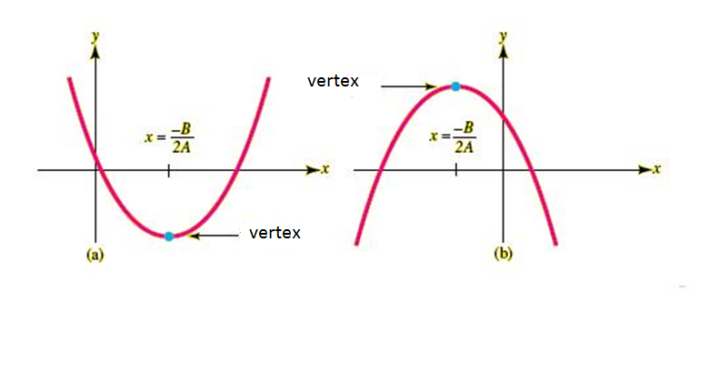
CHAPTER I
FUNCTION-GRAPH &LIMITS
Lecturer: TRAN THI TO NHU
NATURAL SCIENCE DEPATERMENT

Slide 2
DEFINITION
FUNCTION
A function is a rule assign to each other in set X exactly each other in set Y.
Where
X is called the domain of the function
Y is called the range of the function

Slide 4
Example1

Slide 5
Example 2

Slide 6
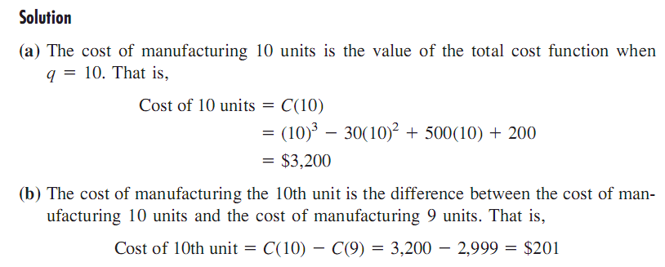

Slide 7
DEFINITION
COMPOSITION OF FUNCTION
Given functions f(u) and g(x), the compsition f[g(x)] is the function of x formed by subtituting u=g(x) for u in the formula for f(u)

Slide 9
Example 3

